Slide 1

CROWDFUNDING ANALYSIS PROJECT
Group-3
1.Nivedita Yadav
2.Gandham Sowmya
3.Sunayana Mahekar
4.Shreyal Gedam
5.Anuja Shrivastava
6.Archana Parmar
7.Gopisetty SaiPavanKalyan

Slide 2
1.Introduction
2.Data Overview
3.Objectives : KPIs
4.Dashboard
5.Analysis
6.Recommendations & Insights
Contents
Notes:
1.Introduction
2.Data Overview
3.Objectives : KPIs
4.Dashboard
5.Analysis
6.Recommendations and Insights
7.Conclusion

Slide 3
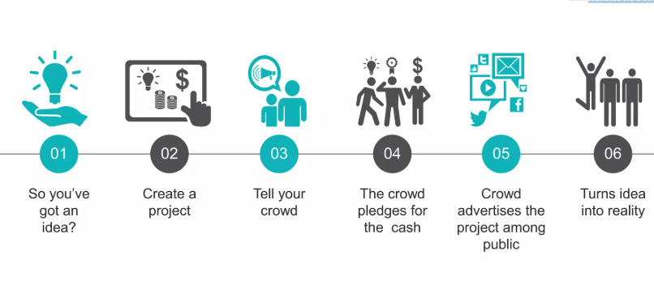
Introduction
Crowdfunding is a collective effort by people who network and contribute collectively for a cause or a business idea.
“Crowdfunding is the practice of funding a project or venture by raising many small amounts of money from a large number of people, typically via internet”
Offers individuals or businesses a chance to succeed by showcasing their businesses and projects to entire world.
Alternative solution to lack of funds.
Notes:
1.Introduction
2.Data Overview
3.Objectives : KPIs
4.Dashboard
5.Analysis
6.Recommendations and Insights
7.Conclusion

Slide 4
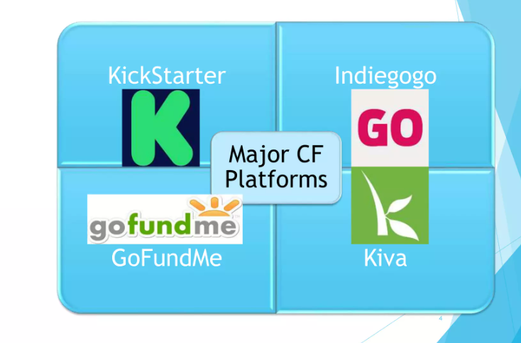
Notes:
1.Introduction
2.Data Overview
3.Objectives : KPIs
4.Dashboard
5.Analysis
6.Recommendations and Insights
7.Conclusion

Slide 5
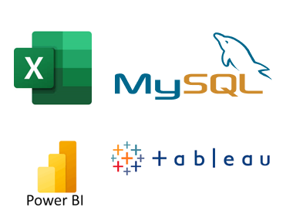
Data Overview
By analyzing this dataset, we aim to understand the performance of the CROWDFUNDING Dataset, identify trends and extracts valuable insights to drive business growth and improve overall efficiency.
Analysis tools: Excel, MySQL, Power BI, Tableau
The project will involve exploring different aspects of Kickstarter, including its crowdfunding model, how it supports creative projects, the role of backers, and its business model.
It will also delve into the reasons why people back projects, the rewards system, and the platform's impact on innovation and creativity.
Notes:
1.Introduction
2.Data Overview
3.Objectives : KPIs
4.Dashboard
5.Analysis
6.Recommendations and Insights
7.Conclusion

Slide 6
KPI 1
Notes:
1.Introduction
2.Data Overview
3.Objectives : KPIs
4.Dashboard
5.Analysis
6.Recommendations and Insights
7.Conclusion

Slide 7
KPI 2
Notes:
1.Introduction
2.Data Overview
3.Objectives : KPIs
4.Dashboard
5.Analysis
6.Recommendations and Insights
7.Conclusion

Slide 8
KPI 3
Notes:
1.Introduction
2.Data Overview
3.Objectives : KPIs
4.Dashboard
5.Analysis
6.Recommendations and Insights
7.Conclusion

Slide 9
Excel Dashboard
Notes:
1.Introduction
2.Data Overview
3.Objectives : KPIs
4.Dashboard
5.Analysis
6.Recommendations and Insights
7.Conclusion

Slide 10
Tableau Dashboard
Notes:
1.Introduction
2.Data Overview
3.Objectives : KPIs
4.Dashboard
5.Analysis
6.Recommendations and Insights
7.Conclusion

Slide 11
Power bi Dashboard
Notes:
1.Introduction
2.Data Overview
3.Objectives : KPIs
4.Dashboard
5.Analysis
6.Recommendations and Insights
7.Conclusion

Slide 12
Analysis
Notes:
1.Introduction
2.Data Overview
3.Objectives : KPIs
4.Dashboard
5.Analysis
6.Recommendations and Insights
7.Conclusion

Slide 13
Recommendations & Insights
Notes:
1.Introduction
2.Data Overview
3.Objectives : KPIs
4.Dashboard
5.Analysis
6.Recommendations and Insights
7.Conclusion

